Slide 1

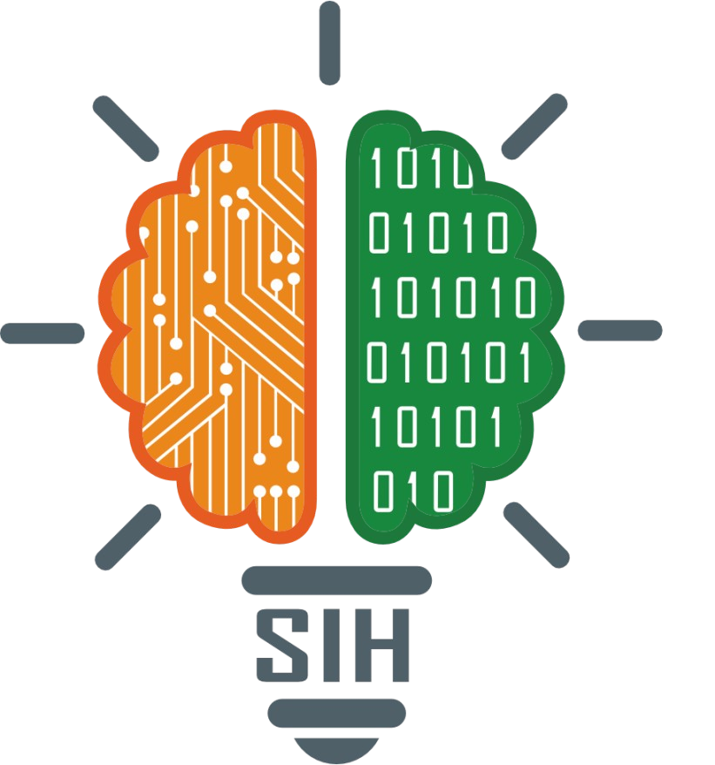
SMART INDIA HACKATHON 2026
TITLE PAGE
Problem Statement ID – 26200
Problem Statement Title- Student innovation-innovative ideas that helps manage and generate renewable/sustainable sources more efficiently
Theme- Renewable Energy
PS Category- Software
Team ID-
Team Name (Registered on portal)

Slide 2
IDEA TITLE
Team Matrix
Wattsense : AI based battery management system :-
AI-powered IoT device that monitors renewable energy battery systems in real time — battery %, runtime and power flow, via current/voltage sensors and an ESP32
Auto-detects new appliances via current signature (zero manual setup) and uses AI to turn raw data into predictive, actionable usage suggestions
USP: zero-config detection + predictive AI + platform-agnostic dashboard — unlike closed systems (e.g. Tesla Powerwall)
•
•

Slide 3
TECHNICAL APPROACH
Team Matrix
•
Hardware: ESP32, INA219/INA226 sensors, Li-ion battery + BMS, solar panel, relay module
Software: Arduino/C++, Firebase real-time DB, web/app dashboard, AI/LLM API for recommendations
Sensors read battery, solar input and appliance-level current; Coulomb counting gives battery % and runtime
New appliances auto-detected via current-signature matching; data syncs to the cloud, where AI generates usage suggestions for the dashboard
•
•
•

Slide 4
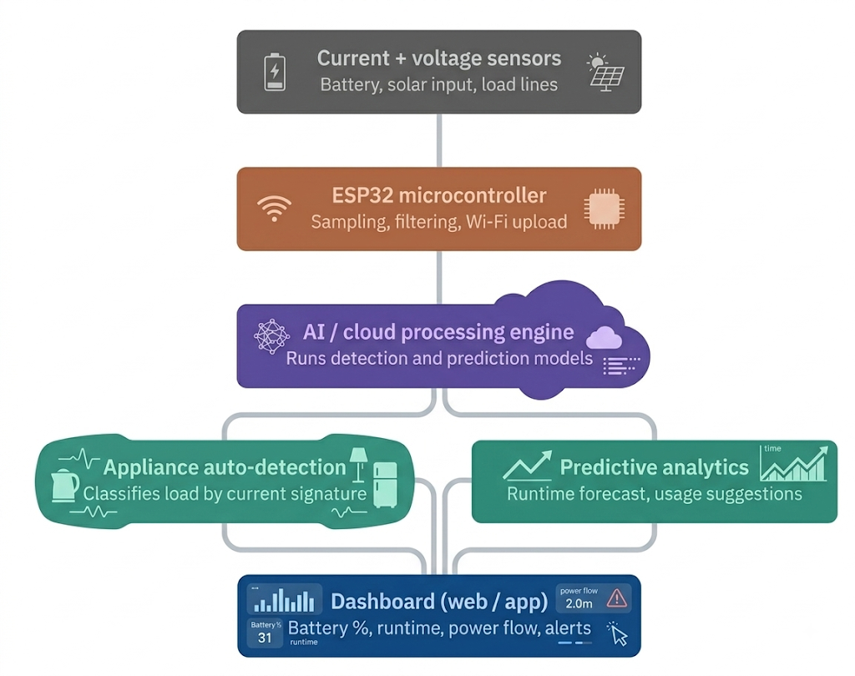
SYSTEM ARCHITECTURE
Team Matrix

Slide 5
FEASIBILITY AND VIABILITY
Team Matrix
•
Technically feasible: built on proven techniques — Coulomb counting, I2C current sensing, NILM-based load detection — not unproven methods
Key risks: limited appliance-signature accuracy at prototype scale, small-battery testing limits, and a simplified AI layer
Mitigation strategies: expand signature testing, validate accuracy with a calibrated multimeter, and use a hybrid rules + AI approach for explainable suggestions
•
•

Slide 6
IMPACT AND BENEFITS
Team Matrix
Helps households, rural/off-grid users, small businesses and telecom/farm solar-battery setups cut energy waste and use renewable power efficiently, without needing technical expertise to configure it
Social: easier renewable adoption for non-technical users | Economic: lower electricity costs via better usage habits | Environmental: less energy waste, higher effective use of clean energy generated

Slide 7
RESEARCH AND REFERENCES
Team Matrix
•
Zeifman & Roth, "Nonintrusive Appliance Load Monitoring: An Overview"— ncbi.nlm.nih.gov/pmc/articles/PMC6720010
"Implementation of Coulomb Counting Method for Estimating SoC of Li-Ion Battery" (Arduino-based) — journalpsij.com/index.php/PSIJ/article/view/687
"Monitoring Battery and Load Control of Solar Power Plants Using IoT" (ESP32 + INA219) — journal.esrgroups.org/jes/article/view/5442
•
•

